Slide 1
LITERARY TRANSLATION Cô bé bán diêm – Ngữ Văn 8 (THE LITTLE MATCH GIRL)
Instructor:
Dr Ho-Dac, Tuc
Students:
Huynh Phuoc Loc
Nguyen Quoc Tai
Nguyen Triet

Slide 2
Main parts
Definition and Significance of literary translation
Translating the title of the story
Plot of story
Sample text
Meaning of story
References

Slide 3
1. Definition and Significance
The movement of a text from one language into another in an equal linguistic exchange. (Casanova, 2010)
Poetry, plays, literary books, literary texts, as well as songs, rhymes, literary articles, fiction novels, novels, short stories, poems, etc. Translate the language, translate their culture. (Laura Bazzurro)

Slide 4
The acts of human communication
Giving us insights into
=> why we find it difficult sometimes to speak to each other
=> why we particularly like or understand what the other has written (Bell, 1991)

Slide 5
2. Translating the title
- A constituent element of the textual world
- Literary title functions as a proper name as a consequence of particularization
The literary title carries an idea or an argument relevant to the text (Briffa & Caruana, 2009)
=> Using: literal approach

Slide 6
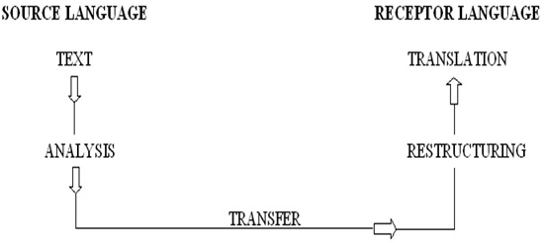
Target readers: Vietnamese children and adults

Slide 7
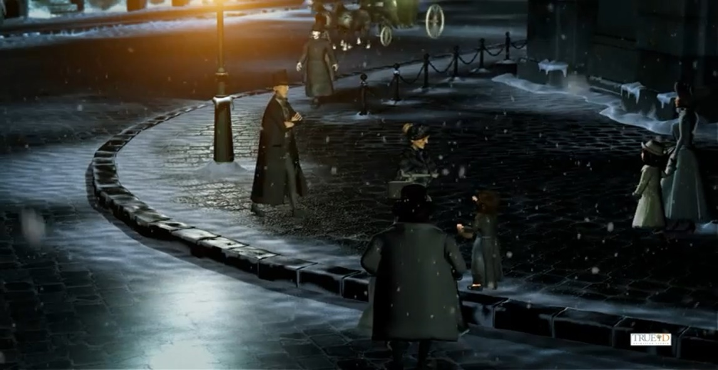
3. Plot of story

Slide 8
4. Sample text

Slide 9
5. Meaning of story
Through fairy tales for children, Andersen told a story for adults. Indifference, insensitivity and selfishness are bad habit of human being. It exists not only abstract generalities but also exists in even the close relatives, at the same age, and in those people who wear big warm clothing with the joy of Christmas New Year. They forced the poor girl going to death and did not know about her dreams when scratching the matches

Slide 10
6. References
Laura, B. Literary translation <http://conalti.org/?p=642>. Retrieved 25.01.2015
Bell, R. T. (1991). Translation and translating (Vol. 56): London: Longman. Retrieved 25.01.2015
Briffa, C., & Caruana, R. M. (2009). Stylistic Creativity when Translating Titles. Paper presented at the Online Proceedings of the Annual Conference of the Poetics and Linguistics Association(PALA). Retrieved 25.01.2015
Casanova, P. (2010). Consecration and accumulation of literary capital: translation as unequal exchange. translated from French by S. Brownlie, in M. Baker (ed.) Critical Readings in Translation Studies, Abingdon and New York: Routledge. Retrieved 25.01.2015
Ho, Dac Tuc. 2012. Dịch thuật và tự do. Nhà xuất bản Công ty TNHH Sách Phương Nam và Đại học Hoa Sen. Retrieved 25.01.2015

Slide 11
THANK YOU FOR YOUR ATTENTION
Comments and suggestions
quoctai.av94@gmail.com

